Slide 1
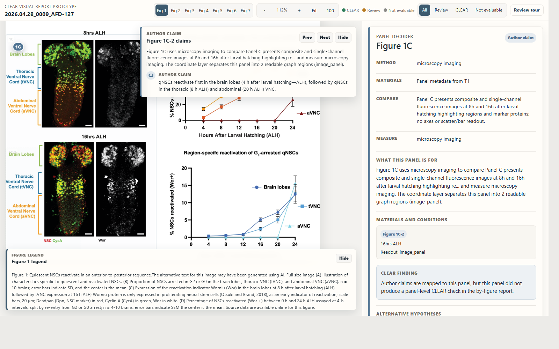
Figures become interfaces
CLEAR visual report with panel- and graph-level coordinates
2026.04.28_0009_AFD-127 | generated from Panel_sheet.json coordinates

Slide 2
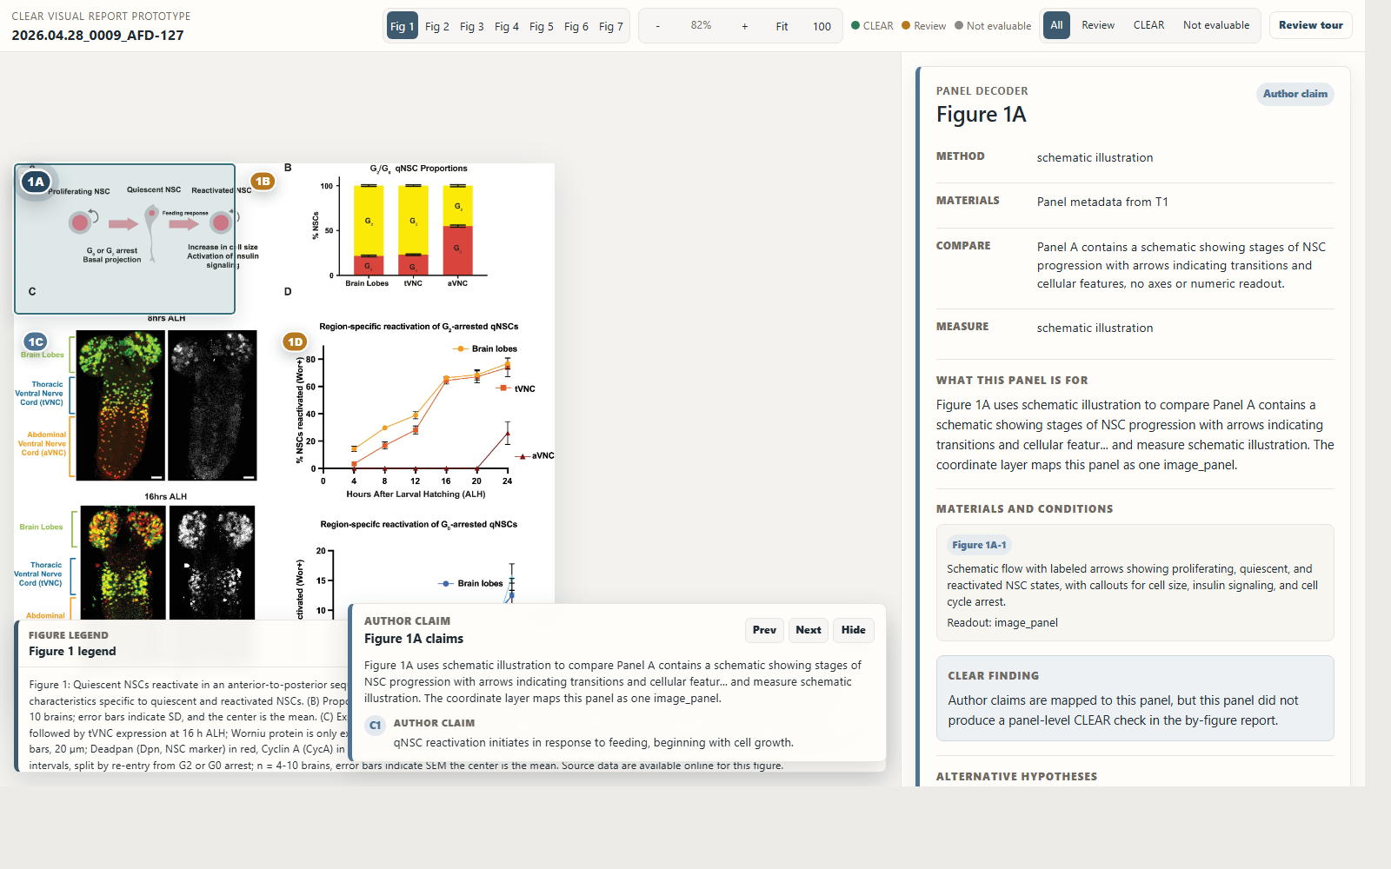
SCHEMATIC AUTHOR CLAIM
Schematic panels become claim surfaces
Even schematic panels are clickable. The reader sees author claims attached to the visual object rather than hunting through prose.
CLEAR visual report | 2026.04.28_0009_AFD-127
2

Slide 3
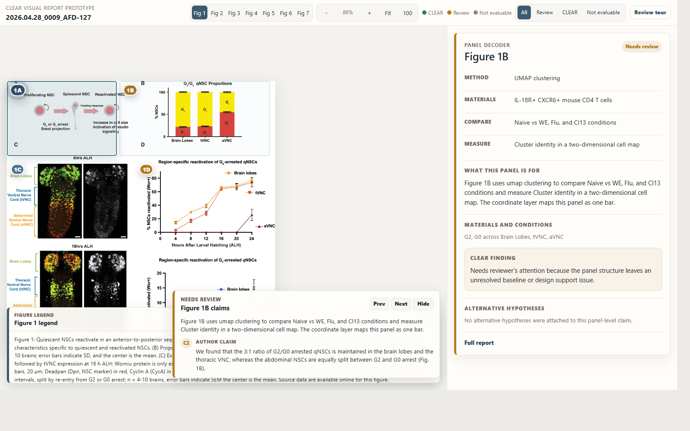
REVIEW PANEL
Panel-level evidence is framed directly
Clicking a panel selects its evidence region and gathers the mapped claims, materials, conditions, and CLEAR finding.
CLEAR visual report | 2026.04.28_0009_AFD-127
3

Slide 4
GRAPH FOCUS
Graph-level focus changes the unit of reading
The same panel can now be read at graph resolution, narrowing the decoder to graph-specific materials and conditions.
CLEAR visual report | 2026.04.28_0009_AFD-127
4

Slide 5
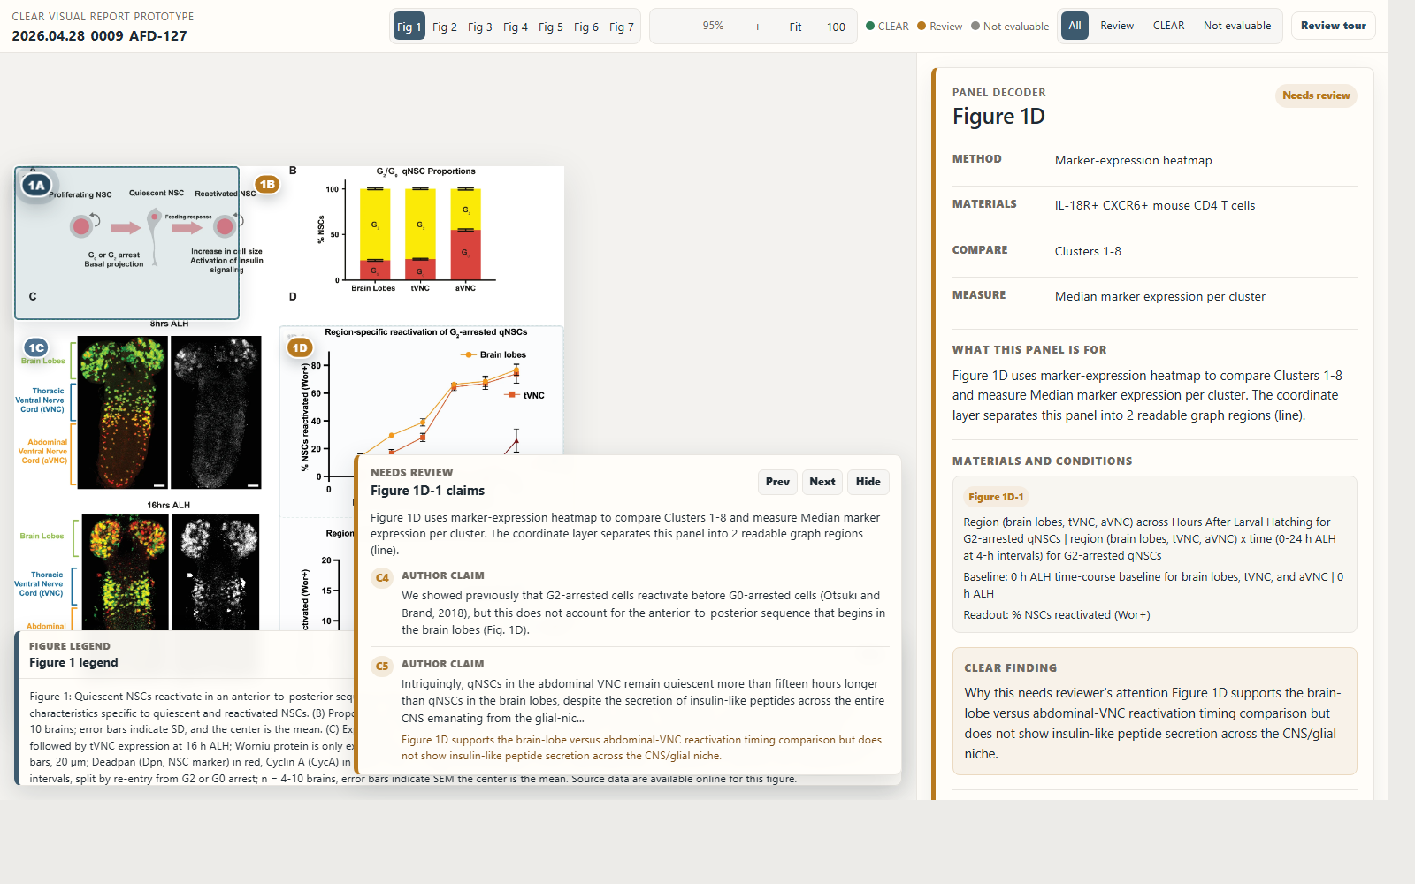
ALTERNATIVE HYPOTHESES
Alternative hypotheses stay attached to evidence
Alternative hypotheses can be shown next to the exact evidence they challenge, instead of buried in a report section.
CLEAR visual report | 2026.04.28_0009_AFD-127
5

Slide 6
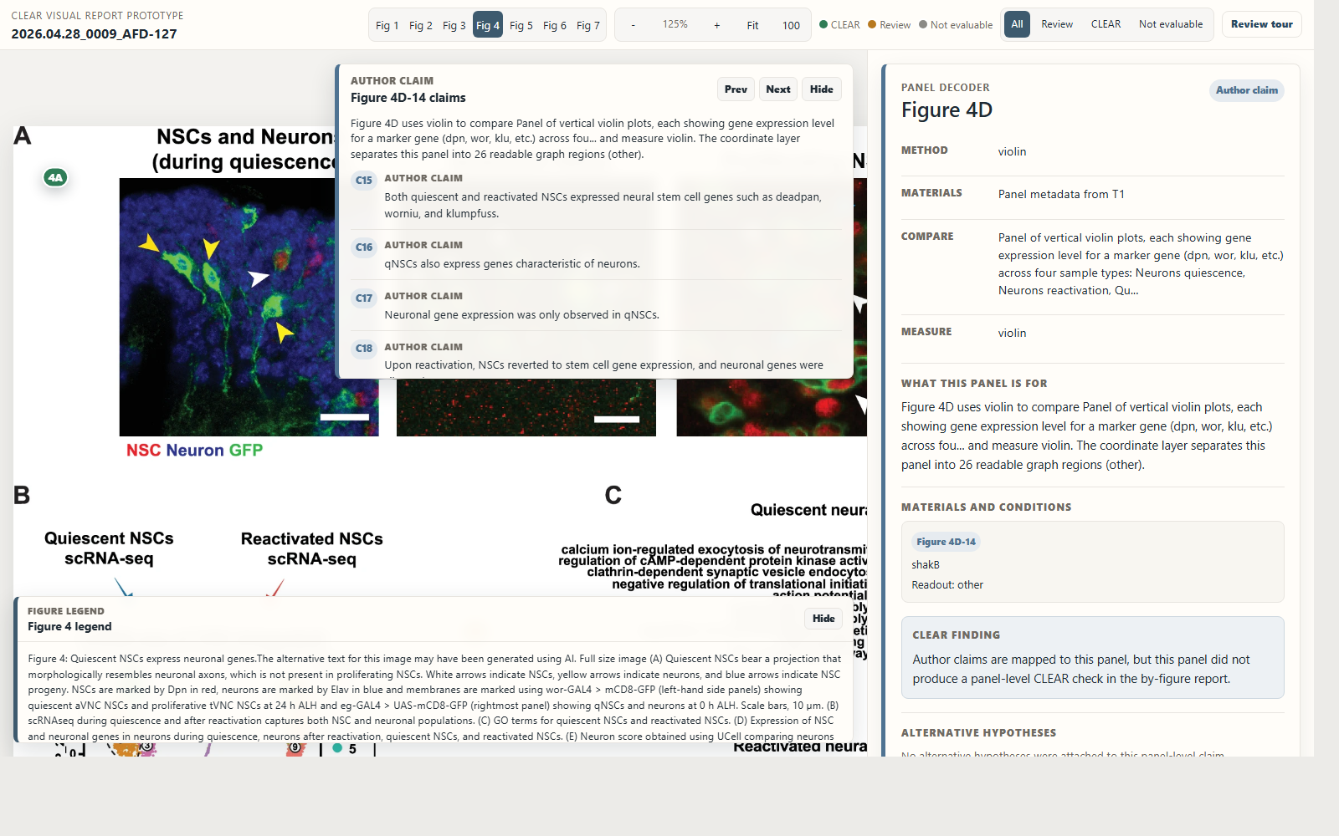
DENSE GRAPH PANEL
Dense figures become navigable anatomy
Crowded panels become navigable anatomy: many graph regions remain inspectable without turning into a wall of text.
CLEAR visual report | 2026.04.28_0009_AFD-127
6

